Slide 1


International Economics: Theory and Policy
Twelfth Edition
Chapter 6
The Standard Trade Model
Copyright © 2022, 2018, 2015 Pearson Education, Inc. All Rights Reserved
Notes:
If this PowerPoint presentation contains mathematical equations, you may need to check that your computer has the following installed:
1) MathType Plugin
2) Math Player (free versions available)
3) NVDA Reader (free versions available)

Slide 2
Learning Objectives (1 of 2)
6.1 Understand how the components of the standard trade model, production possibilities frontiers, isovalue lines, and indifference curves fit together to illustrate how trade patterns are established by a combination of supply-side and demand-side factors.
6.2 Recognize how changes in the terms of trade and economic growth affect the welfare of nations engaged in international trade.

Slide 3
Learning Objectives (2 of 2)
6.3 Understand the effects of tariffs and subsidies on trade patterns and the welfare of trading nations and on the distribution of income within countries.
6.4 Relate international borrowing and lending to the standard trade model, where goods are exchanged over time.

Slide 4
Preview
Relative supply and relative demand
The terms of trade and welfare
Effects of economic growth, import tariffs, and export subsidies
International borrowing and lending

Slide 5
Introduction (1 of 3)
Standard trade model is a general model that includes Ricardian, specific factors, and Heckscher-Ohlin models as special cases.
Two goods, food (F) and cloth (C).
Each country’s P P F is a smooth curve.

Slide 6
Introduction (2 of 3)
Differences in labor services, labor skills, physical capital, land, and technology between countries cause differences in production possibility frontiers.
A country’s P P F determines its relative supply function.
National relative supply functions determine a world relative supply function, which along with world relative demand determines the equilibrium under international trade.

Slide 7
Introduction (3 of 3)
The standard trade model is built on four key relationships:
the relationship between the production possibility frontier and the relative supply curve,
the relationship between relative prices and relative demand,
the determination of world equilibrium by world relative supply and world relative demand, and
the effect of the terms of trade—the price of a country’s exports divided by the price of its imports—on a nation’s welfare.

Slide 8
Production Possibilities and Relative Supply (1 of 2)
What a country produces depends on the relative price of
cloth to food
An economy chooses its production of cloth
and food
to maximize the value of its output
given the prices of cloth and food.
The slope of an isovalue line equals
Produce at point where P P F is tangent to isovalue line.

Slide 9
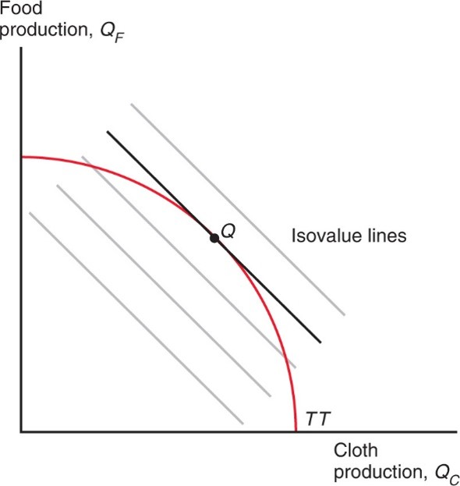
Figure 6.1 Relative Prices Determine the Economy’s Output
An economy whose production possibility frontier is T T will produce at Q, which is on the highest possible isovalue line.
Notes:
The curve for production possibility frontier, T T, falls with decreasing steepness from y to x-axis, through point Q. Point Q intersects an isovalue line, with 3 parallel isovalue lines below the point and one above.

Slide 10
Production Possibilities and Relative Supply (2 of 2)
Relative prices and relative supply:
An increase in the price of cloth relative to food
makes the isovalue line steeper.
Production shifts from point
to point
Supply of cloth relative to food
rises.
Relative supply of cloth to food increases with the relative price of cloth to food.

Slide 11
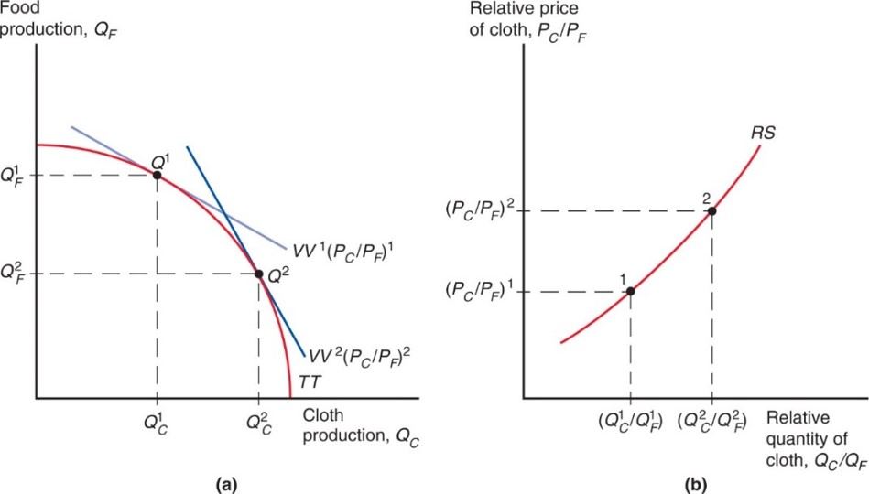
Figure 6.2 How an Increase in the Relative Price of Cloth Affects Relative Supply
In panel (a), the isovalue lines become steeper when the relative price of cloth rises. As a result, the economy produces more cloth and less food. Panel (b) shows the relative supply curve associated with the production possibilities frontier T T. The rise in the relative price of cloth leads to an increase in the relative production of cloth.
Notes:
The curve, T T, falls through points Q super 1 then Q super 2. At point Q super 1, x – Q sub C super 1, y = Q sub F super 1, and slope = V V super 1, left parenthesis, P sub C over P sub F, right parenthesis, super 1. At point Q super 2, x = Q sub C super 2, y = Q sub F super 2, and the slope is less steep, V V super 2, left parenthesis, P sub C over P sub F, right parenthesis, super 2. The second graph in panel b plots the relative supply of cloth, P sub C over P sub F, versus the relative quantity of cloth, Q sub C over Q sub F. The plot for R S rises with increasing steepness through point 1 then point 2. At point 1, x = Q sub C super 1 over Q sub F super 1, and y = P sub C over P sub F, super 1. At point 2, x = Q sub C super 2 over Q sub F super 2, and y = P sub C over P sub F, super 2.

Slide 12
Relative Prices and Demand (1 of 6)
The value of the economy’s consumption must equal the value of the economy’s production.
Assume that the economy’s consumption decisions may be represented as if they were based on the tastes of a single representative consumer.
An indifference curve represents combinations of cloth and food that leave the consumer equally well off (indifferent).

Slide 13
Relative Prices and Demand (2 of 6)
Indifference curves
are downward sloping—if you have less cloth, then you must have more food to be equally satisfied.
that lie farther from the origin make consumers more satisfied—they prefer having more of both goods.
become flatter when they move to the right—with more cloth and less food, an extra yard of cloth becomes less valuable in terms of how many calories of food you are willing to give up for it.

Slide 14
Relative Prices and Demand (3 of 6)
Consumption choice is based on preferences and relative price of goods:
Consume at point D where the isovalue line is tangent to the indifference curve.
Economy exports cloth—the quantity of cloth produced exceeds the quantity of cloth consumed—and imports food.

Slide 15
Relative Prices and Demand (4 of 6)
Relative prices and relative supply:
An increase in the relative price of cloth
causes
consumption choice to shift from point
to point
Demand for cloth relative to food
falls.
Relative supply of cloth to food increases with the relative price of cloth to food.

Slide 16
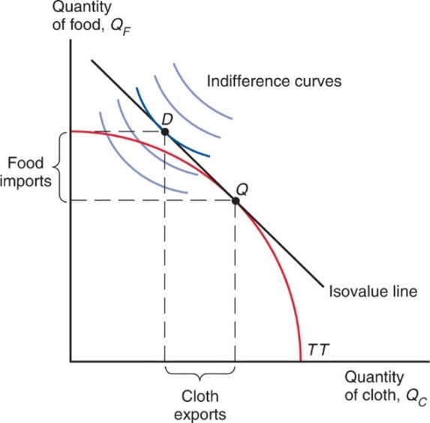
Figure 6.3 Production, Consumption, and Trade in the Standard Model
The economy produces at point Q, where the production possibility frontier is tangent to the highest possible isovalue line. It consumes at point D, where that isovalue line is tangent to the highest possible indifference curve. The economy produces more cloth than it consumes and therefore exports cloth; correspondingly, it consumes more food than it produces and therefore imports food.
Notes:
The curve T T falls with increasing steepness from y to x-axis, through point Q, at roughly the midpoint. An isovalue line passes through point Q on the curve and extends to point D above the curve to the left. The horizontal difference between points D and Q represents cloth exports. The vertical difference between points D and Q represents food imports. An indifference curve opens to the right through point D. There are 4 more parallel indifference curves, 2 below and 2 above point D.

Slide 17
Relative Prices and Demand (5 of 6)
An economy that exports cloth is better off when the price of cloth rises relative to the price of food:
the isovalue line becomes steeper and a higher indifference curve can be reached.
A higher relative price of cloth means that more calories of food can be imported for every yard of cloth exported.

Slide 18
Relative Prices and Demand (6 of 6)
If the economy cannot trade:
The relative price of cloth to food is determined by the intersection of relative demand and relative supply for that country.
Consume and produce at point
where the
indifference curve is tangent to the production possibilities frontier.

Slide 19
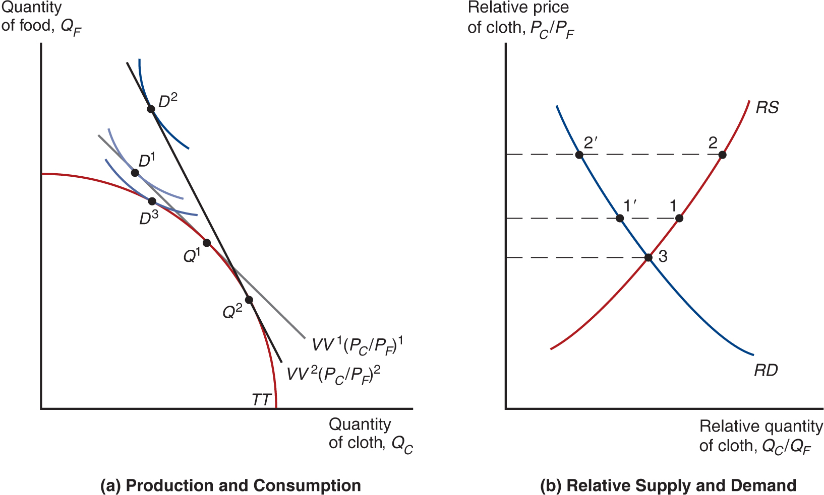
Figure 6.4 Effects of a Rise in the Relative Price of Cloth and Gains from Trade
In panel (a), the slope of the isovalue lines is equal to minus the relative price of cloth. As a result, when that relative price rises, all isovalue lines become
steeper. Production shifts from
and consumption shifts from
the economy cannot trade, then it produces and consumes at point
Panel (b) shows the effects of the rise in the relative price of cloth on relative production (move from 1 to 2) and relative demand (move from 1 to 2). If the economy cannot trade, then it consumes and produces at point 3.
Notes:
Curve T T falls with increasing steepness through points D super 3, Q super 1, and Q super 2. An indifference curve intersects point D super 3, with a parallel indifference curve above and to the left of D super 3, with point D super 1. An isovalue line with slope V V super 2, left parenthesis P sub C over P sub F, right parenthesis, super 2, intersects point Q super 2 on the T T curve. The line also intersects point D super 2 on an indifference curve above and to the right of the curve with point D super 1. Another isovalue line, with slope V V super 1, left parenthesis P sub C over P sub F, right parenthesis, super 1, intersects point Q super 1 on curve T T, and point D super 1 on the indifference curve. The slope of this line is less steep than the one that passes through point Q super 2 on curve T T.

Slide 20
U.S. Consumer Gains from Chinese Imports (1 of 2)
The aggregate gains from trade are in large part driven by consumers’ access to cheaper imported goods.
Increased trade between the United States and China has increased the purchasing power of U.S. consumers.
A recent study finds that increased trade with China between 2000 and 2007 induced large reductions in prices, generating substantial increases in the purchasing power of U.S. households.
On average those gains represented $1,500 per household per year.

Slide 21
U.S. Consumer Gains from Chinese Imports (2 of 2)
Over half of those gains were generated by price reductions of U.S. produced goods in response to the increased competition from Chinese imports.
And because those price decreases were more pronounced for goods consumed by relatively poorer households with annual incomes below $30,000, the average $1,500 gain was 36 percent higher for those households relative to richer households with income above $100,000.

Slide 22
The Welfare Effects of Changes in the Terms of Trade
The terms of trade refers to the price of exports relative to the price of imports.
When a country exports cloth and the relative price of cloth increases, the terms of trade rise.
Because a higher relative price for exports means that the country can afford to buy more imports, an increase in the terms of trade increases a country’ s welfare.
A decline in the terms of trade decreases a country’s welfare.

Slide 23
Determining Relative Prices
To determine the price of cloth relative to the price food, use relative supply and relative demand.
World supply of cloth relative to food at each relative price.
World demand for cloth relative to food at each relative price.
World quantities are the sum of quantities from the two countries in the world:
Notes:
Start fraction left parenthesis Q sub C + Q to the asterisk power sub C right parenthesis over left parenthesis Q sub F + Q to the asterisk power sub F right parenthesis end fraction and start fraction left parenthesis D sub C + D to the asterisk power sub C right parenthesis over left parenthesis D sub F + D to the asterisk power sub F right parenthesis end fraction.

Slide 24
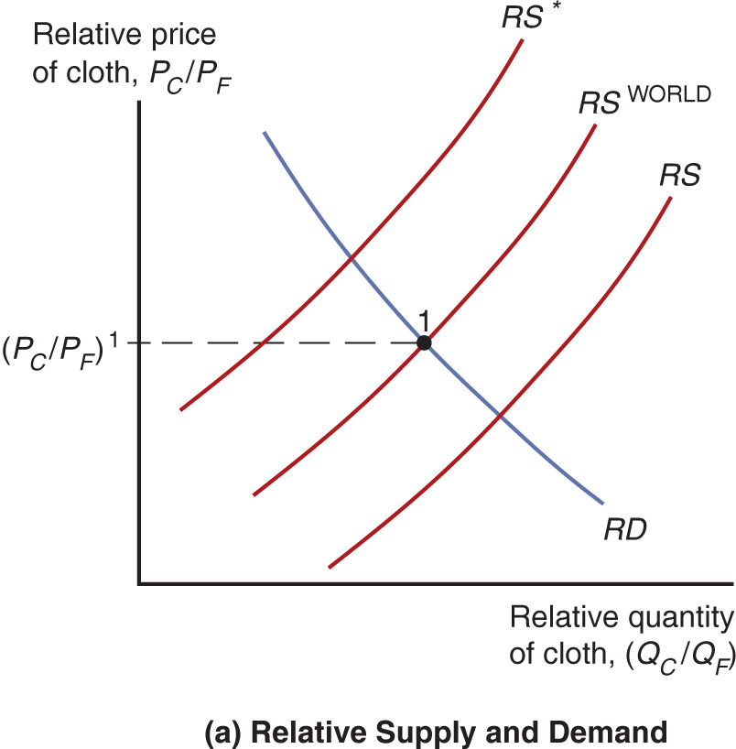
Figure 6.5a Equilibrium Relative Price with Trade and Associated Trade Flows
Notes:
3 parallel R S curves rise with increasing steepness, from left to right: R S asterisk, R S super world, and R S. The R D curve falls with decreasing steepness through all R S curves, intersecting the R S super world curve at point 1, where y = P sub C over P sub F, super 1.

Slide 25
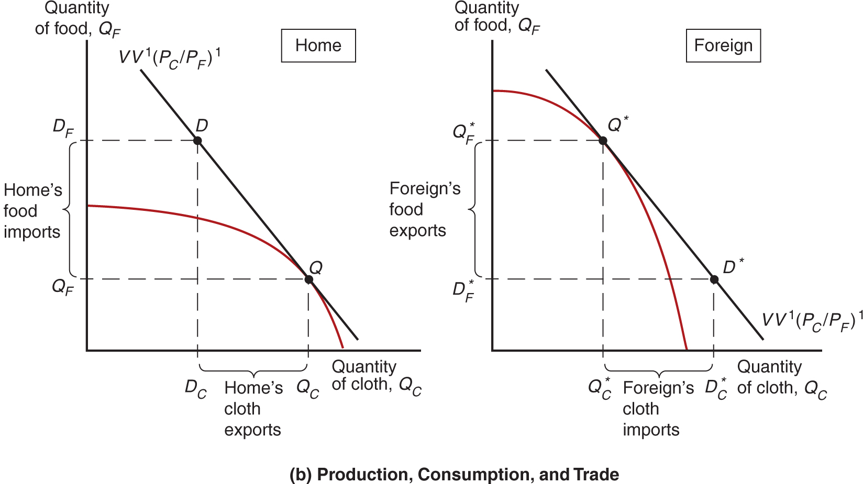
Figure 6.5b Equilibrium Relative Price with Trade and Associated Trade Flows
Notes:
The home production possibility frontier falls to the right with increasing steepness, through point Q. A point Q, x = Q sub C, and y = Q sub F. An isovalue line falls through point D above the curve to point Q on the curve. At point D, x = D sub C, and y = D sub F. The vertical difference between D sub F and Q sub F on the y-axis represents home’s food imports. The horizontal difference between D sub C and Q sub C on the x-axis represents home’s cloth exports.On the second graph, the foreign production possibility frontier is flipped, compared to the home curve, beginning higher on the y-axis and falling with increasing steepness. The curve passes through point Q asterisk, where x = Q sub C asterisk and y = Q sub F asterisk. The isovalue line has the same slope but intersects the frontier at Q asterisk and then falls through point D asterisk. Foreign’s food exports on the y-axis is the difference of Q sub F asterisk and D sub F asterisk. Foreign’s cloth imports on the x-axis is the difference between Q sub C asterisk and D sub C asterisk.

Slide 26
International Effects of Growth (1 of 5)
Is economic growth in China good for the standard of living in the United States?
Is growth in a country more or less valuable when it is integrated in the world economy?
The standard trade model gives us precise answers to these questions.

Slide 27
International Effects of Growth (2 of 5)
Growth is usually biased: it occurs in one sector more than others, causing relative supply to change.
Rapid growth has occurred in U.S. computer industries but relatively little growth has occurred in U.S. textile industries.
In the Ricardian model, technological progress in one sector causes biased growth.
In the Heckscher-Ohlin model, an increase in one factor of production causes biased growth.

Slide 28
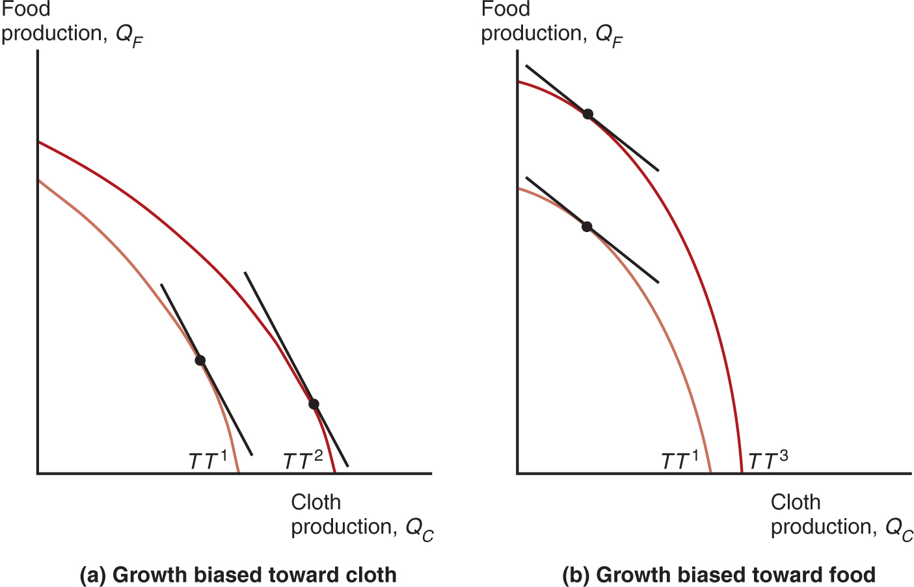
Figure 6.6 Biased Growth (1 of 2)
Growth is biased when it shifts production possibilities out more toward one good than toward another. In case (a), growth is biased toward cloth, while in case (b), growth is biased toward food.
Notes:
Curve T T super 1 is to the left of and below curve T T super 2; both curves fall with increasing steepness. Points with the same slope are plotted on each curve; on T T super 2, the point is lower and to the right. Graph b, growth biased toward food, plots food production, Q sub F, versus cloth production, Q sub C. Curve T T super 1 is to the left of and below curve T T super 3; both curves fall with increasing steepness. Points with the same slope, less steep than the lines in graph ay, are plotted on each curve; on T T super 3, the point is higher and to the left.

Slide 29
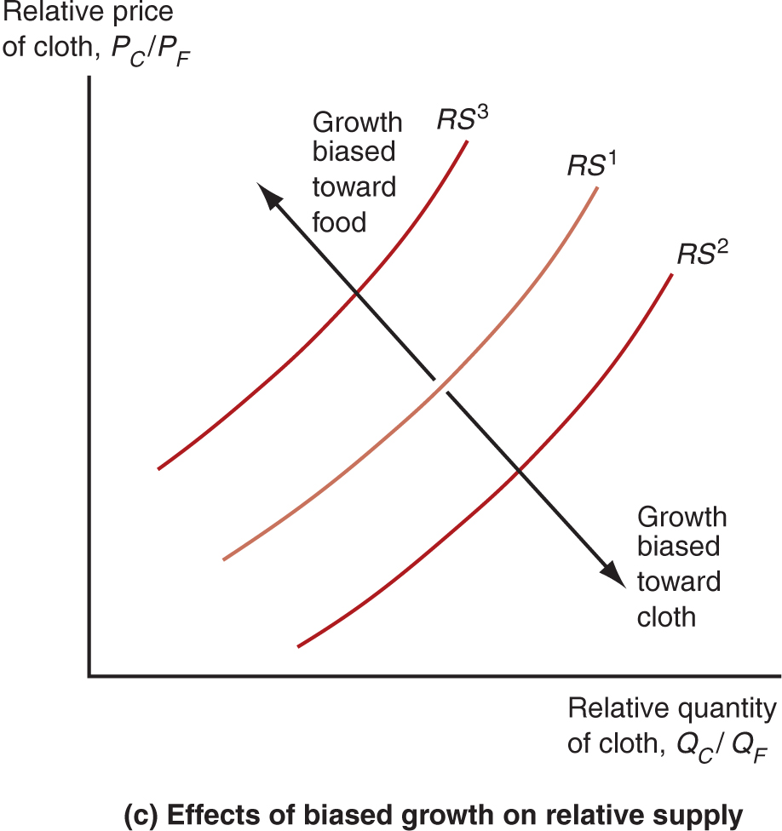
Figure 6.6 Biased Growth (2 of 2)
The associated shifts in the relative supply curve are shown in
panel (c): shift to the right
when growth is
biased toward cloth, and shift to the left
when growth is biased toward food.
Notes:
The relative price of cloth is on the y-axis versus the relative quantity of cloth on the x-axis. Three parallel R S curves, rise with increasing steepness, from left to right as follows: R S super 3, R S super 1, and R S super 2. A line with arrows at each end intersects all 3 curves. As the rises, to the left, growth is biased toward food. As the falls, to the right, growth is biased toward cloth.

Slide 30
International Effects of Growth (3 of 5)
Biased growth and the resulting change in relative supply causes a change in the terms of trade.
Biased growth in the cloth industry (in either the home or foreign country) will lower the price of cloth relative to the price of food and lower the terms of trade for cloth exporters.
Biased growth in the food industry (in either the home or foreign country) will raise the price of cloth relative to the price of food and raise the terms of trade for cloth exporters.
Suppose that the home country exports cloth and imports food.

Slide 31
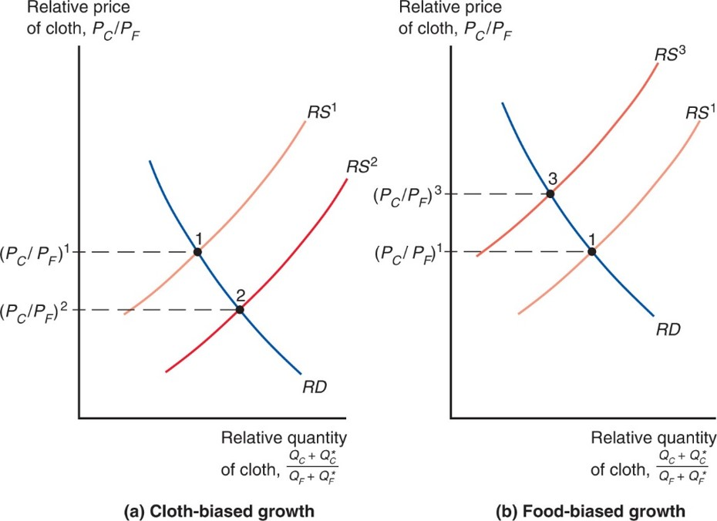
Figure 6.7 Growth and World Relative Supply
Growth biased toward cloth shifts the R S curve for the world to the right (a), while growth biased toward food shifts it to the left (b).
Notes:
Graph ay, cloth-biased growth, shows curve R S super 1 above and to the left of curve R S super 2; both rise with increasing steepness. The R D curve falls with increasing steepness, intersecting R S super 1 at point 1, where y = P sub C over P sub F, super 1; and intersecting R S super 2 at point 2, where y = P sub C over P sub F, super 2. Graph b, food-biased growth, shows curve R S super 3 above and to the left of R S super 1; both rise with increasing steepness. The R D curve falls with increasing steepness, intersecting R S super 1 at point 1, where y = P sub C over P sub F, super 1; and intersecting R S super 3 at point 3, where y = P sub C over P sub F, super 3.

Slide 32
International Effects of Growth (4 of 5)
Export-biased growth is growth that expands a country’s production possibilities disproportionately in that country’s export sector.
Biased growth in the food industry in the foreign country is export-biased growth for the foreign country.
Import-biased growth is growth that expands a country’s production possibilities disproportionately in that country’s import sector.
Biased growth in cloth production in the foreign country is import-biased growth for the foreign country.

Slide 33
International Effects of Growth (5 of 5)
Export-biased growth reduces a country’s terms of trade, reducing its welfare and increasing the welfare of foreign countries.
Import-biased growth increases a country’s terms of trade, increasing its welfare and decreasing the welfare of foreign countries.

Slide 34
Has the Growth of Newly Industrializing Economies Hurt Advanced Nations? (1 of 3)
Has the United States suffered from a deterioration in its terms of trade as some of its main trading partners (such as China) experienced rapid growth?
This would represent an aggregate income loss for the United States.
The standard trade model predicts that if the growth in China is mainly import-biased, the growth in sectors that compete with U.S. exports would reduce the U.S. terms of trade.

Slide 35
Has the Growth of Newly Industrializing Economies Hurt Advanced Nations? (2 of 3)
But data indicates that changes in the U.S. terms of trade have been small with no clear trend over last few decades.
The U.S. terms of trade in 2014 was essentially at the same level as it was in 1980.
The terms of trade for China have deteriorated over the past decade, suggesting their recent growth may have been export-biased.

Slide 36
Has the Growth of Newly Industrializing Economies Hurt Advanced Nations? (3 of 3)
Like the United States, most developed countries tend to experience mild swings in their terms of trade, around 1 percent or less a year (on average).
Some developing countries’ exports are heavily concentrated in mineral and agricultural sectors.
The prices of those goods on world markets are very volatile, leading to large swings in the terms of trade.
These swings in turn translate into substantial changes in welfare.

Slide 37
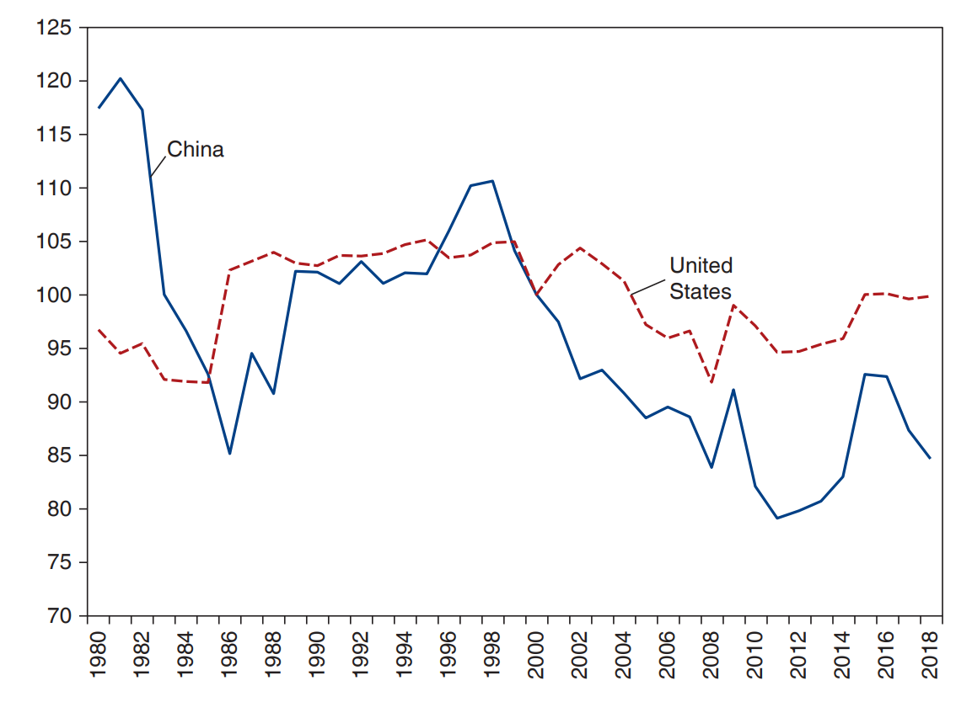
Figure 6.8 Evolution of the Terms of Trade for the United States and China
Source: World Development Indicators, World Bank.
Notes:
A double line graph of the terms of trade between China and the United States plots the terms of trade versus years 19 80 to 20 18. The plot for U S generally rises from (19 81, 95) to (19 95, 105), and then generally falls through (2008, 97), (20 14, 98), and (20 18, 100). After a brief rise, the plot for China falls steeply from (19 81, 120) to (19 86, 85). It then generally rises through (19 89, 103) to (19 98, 110), and then generally falls through (2008, 90), (20 14, 83), and (20 18, 86). All values are estimated.

Slide 38
Import Tariffs and Export Subsidies: Simultaneous Shifts in R S and R D
Import tariffs are taxes levied on imports.
Export subsidies are payments given to domestic producers that export.
Both policies influence the terms of trade and therefore national welfare.
Import tariffs and export subsidies drive a wedge between prices in world markets and prices in domestic markets.

Slide 39
Relative Price and Supply Effects of a Tariff (1 of 2)
If the home country imposes a tariff on food imports, the price of food relative to the price of cloth rises for domestic consumers.
Likewise, the price of cloth relative to the price of food falls for domestic consumers.
Domestic producers will receive a lower relative price of cloth, and therefore will be more willing to switch to food production: relative supply of cloth will decrease.
Domestic consumers will pay a lower relative price for cloth, and therefore will be more willing to switch to cloth consumption: relative demand for cloth will increase.

Slide 40
Relative Price and Supply Effects of a Tariff (2 of 2)
When the home country imposes an import tariff, the terms of trade increase and the welfare of the country may increase.
The magnitude of this effect depends on the size of the home country relative to the world economy.
If the country is a small part of the world economy, its tariff (or subsidy) policies will not have much effect on world relative supply and demand, and thus on the terms of trade.
But for large countries, a tariff may maximize national welfare at the expense of foreign countries.

Slide 41
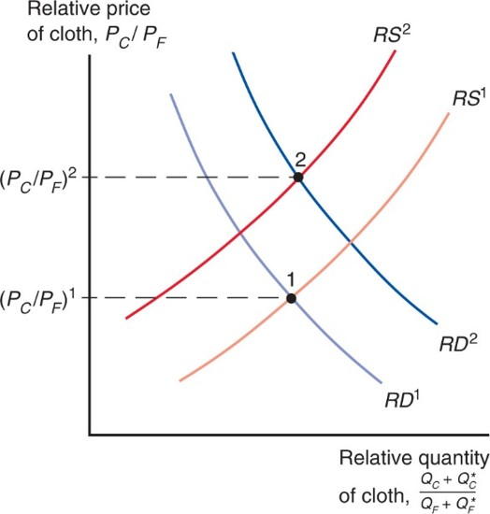
Figure 6.9 Effects of a Food Tariff on the Terms of Trade
An import tariff on food imposed by Home both reduces the relative
supply of cloth
and increases the relative demand
for the world as a whole. As a result, the relative
price of cloth must rise from
Notes:
2 rising R S curves intersect 2 falling R D curves. R S super 1 intersects R D super 1 at point 1, where y = P sub C over P sub F, super 1. R S super 1 is shifted up and to the left for R super 2, and R D super 1 shifts up and to the right for R D super 2. R S super 2 intersects R D super 2 at point 2, where y = P sub C over P sub F, super 2. Point 2 is above and slightly to the right of point 1.

Slide 42
Effects of an Export Subsidy (1 of 2)
If the home country imposes a subsidy on cloth exports, the price of cloth relative to the price of food rises for domestic consumers.
Domestic producers will receive a higher relative price of cloth when they export, and therefore will be more willing to switch to cloth production: relative supply of cloth will increase.
Domestic consumers must pay a higher relative price of cloth to producers, and therefore will be more willing to switch to food consumption: relative demand for cloth will decrease.

Slide 43
Effects of an Export Subsidy (2 of 2)
When the home country imposes an export subsidy, the terms of trade decrease and the welfare of the country decreases to the benefit of the foreign country.

Slide 44
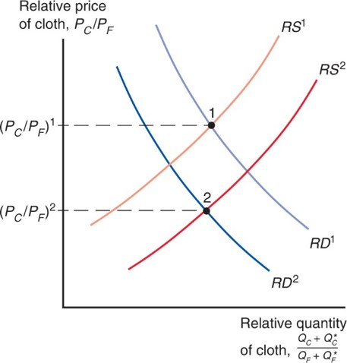
Figure 6.10 Effects of a Cloth Subsidy on the Terms of Trade
An export subsidy on cloth has the opposite effects on relative supply and demand than the tariff on food. Relative supply of cloth for the world rises, while relative demand for the world falls. Home’s terms of trade decline as the
relative price of cloth falls from
Notes:
2 rising R S curves intersect 2 falling R D curves. R S super 1 intersects R D super 1 at point 1, where y = P sub C over P sub F, super 1. R S super 1 is shifted down and to the right for R super 2, and R D super 1 shifts down and to the left for R D super 2. R S super 2 intersects R D super 2 at point 2, where y = P sub C over P sub F, super 2. Point 2 is below and slightly to the left of point 1.

Slide 45
Implications of Terms of Trade Effects: Who Gains and Who Loses? (1 of 4)
The standard trade model predicts that
an import tariff by the home country can increase domestic welfare at the expense of the foreign country.
an export subsidy by the home country reduces domestic welfare to the benefit of the foreign country.

Slide 46
Implications of Terms of Trade Effects: Who Gains and Who Loses? (2 of 4)
Additional effects of tariffs and subsidies that can occur in a world with many countries and many goods:
A foreign country may subsidize the export of a good that the United States also exports, which will reduce the price for the United States in world markets and decrease its terms of trade.
The E U subsidizes agricultural exports, which reduce the price that American farmers receive for their goods in world markets.
A foreign country may put a tariff on an imported good that the United States also imports, which will reduce the price for the United States in world markets and increase its terms of trade.

Slide 47
Implications of Terms of Trade Effects: Who Gains and Who Loses? (3 of 4)
Export subsidies by foreign countries on goods that
the U.S. imports reduce the world price of U.S. imports and increase the terms of trade for the United States
the U.S. also exports reduce the world price of U.S. exports and decrease the terms of trade for the United States
Import tariffs by foreign countries on goods that
the U.S. exports reduce the world price of U.S. exports and decrease the terms of trade for the United States
the U.S. also imports reduce the world price of U.S. imports and increase the terms of trade for the United States.

Slide 48
Implications of Terms of Trade Effects: Who Gains and Who Loses? (4 of 4)
Export subsidies on a good decrease the relative world price of that good by increasing relative supply of that good and decreasing relative demand of that good.
Import tariffs on a good decrease the relative world price of that good (and increase the relative world price of other goods) by increasing the relative supply of that good and decreasing the relative demand of that good.

Slide 49
International Borrowing and Lending (1 of 5)
The standard trade model can be modified to analyze international borrowing and lending.
Two goods are current and future consumption (same good at different times), rather than different goods at the same time.
Countries usually have different opportunities to invest to become able to produce more in the future.
A special kind of production possibility frontier, an intertemporal production possibility frontier, depicts different possible combinations of current output and future output.

Slide 50
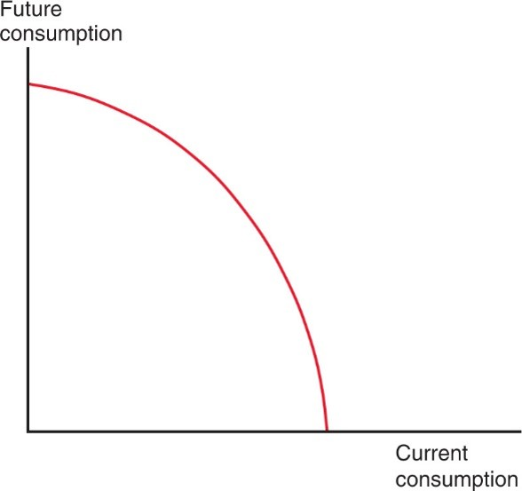
Figure 6.11 The Intertemporal Production Possibility Frontier
A country can trade current consumption for future consumption in the same way that it can produce more of one good by producing less of another.

Slide 51
International Borrowing and Lending (2 of 5)
Suppose that Home has production possibilities biased toward current output, while Foreign has production possibilities biased toward future output.
Foreign has better opportunities to invest now to generate more output in the future.

Slide 52
International Borrowing and Lending (3 of 5)
If you borrow 1 unit of output, you must repay principal + interest = 1 + r in the future, where r is the real interest rate.
The price of future consumption relative to current
consumption is
1 unit of current consumption is worth 1 + r of future consumption,
so 1 unit of future consumption is worth
units of current consumption.

Slide 53
International Borrowing and Lending (4 of 5)
Home exports current consumption and imports future consumption.
Home lends to Foreign by consuming less than it produces now. Home able to consume more than produces in the future when Foreign pays back the loan.
Foreign borrows to be able to consume more than produces now, and pays back the loan by consuming less than produces in the future.

Slide 54
International Borrowing and Lending (5 of 5)
When international borrowing and lending are allowed, the world real interest rate is determined by the intersection of world relative demand and world relative supply.
The world real interest rate will be between the real interest rates that existed in the two country’s prior to intertemporal trade.
The real interest rate rises in the country that lends (home) and falls in the country that borrows (foreign) due to intertemporal trade.

Slide 55
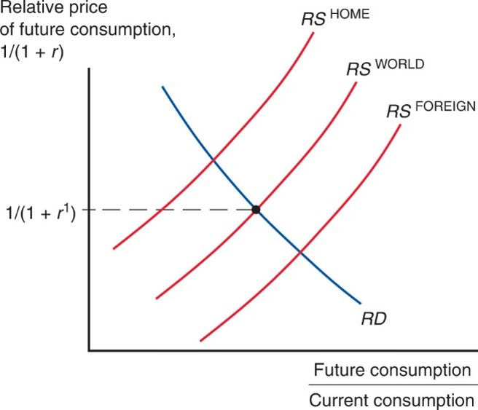
Figure 6.12 Equilibrium Interest Rate with Borrowing and Lending
Home, Foreign, and world supply of future consumption relative to current consumption. Home and Foreign have the same relative demand for future consumption, which is also the relative demand for the world. The equilibrium interest rate is determined by the intersection of world relative supply and demand.

Slide 56
Summary (1 of 3)
The terms of trade refers to the price of exports relative to the price of imports.
Export-biased growth reduces a country’s terms of trade, reducing its welfare and increasing the welfare of foreign countries.
Import-biased growth increases a country’s terms of trade, increasing its welfare and decreasing the welfare of foreign countries.

Slide 57
Summary (2 of 3)
When a country imposes an import tariff, its terms of trade increase and its welfare may increase.
When a country imposes an export subsidy, its terms of trade decrease and its welfare decreases.

Slide 58
Summary (3 of 3)
International borrowing and lending is intertemporal trade, where countries with profitable investment opportunities borrow funds today and repay lenders in the future, benefiting both borrowers and lenders.
The price of future consumption relative to the price of
current consumption,
is determined like any
other relative price.

Slide 59
More On Intertemporal Trade
Intertemporal budget constraint is similar to a regular budget constraint in restricting expenditure to match income, but in present discounted value terms so that trade is balanced intertemporally.
Every unit loaned now permits consuming 1+r more in the future (C = current, F = future).

Slide 60
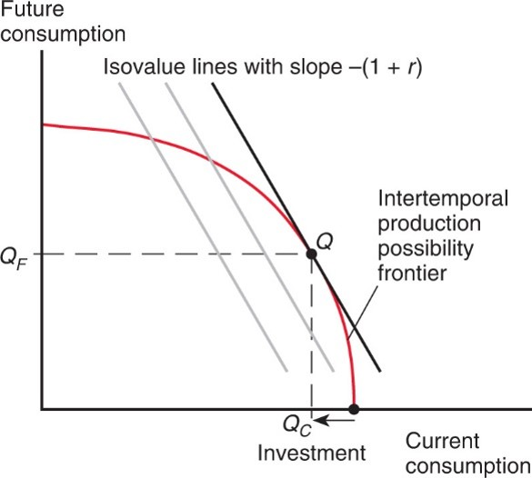
Figure 6A1.1 Determining Home’s Intertemporal Production Pattern
At a world real interest rate of r, Home’s investment level maximizes the value of production over the two periods that the economy exists.
Notes:
The curve falls with increasing steepness through point Q. Three parallel isovalue lines have a slope of negative, 1 + r. The isovalue line furthest to the right is tangent to the curve at point Q. A point Q, Q sub C and y = Q sub F. The horizontal distance between the point where the curve intersects the x-axis and x = Q sub C, to the left, represents a decrease in investment.

Slide 61
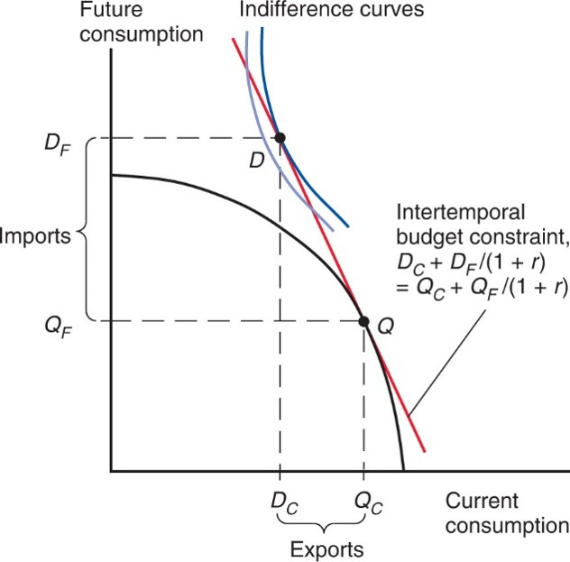
Figure 6A1.2 Determining Home’s Intertemporal Consumption Pattern
Home’s consumption places it on the highest indifference curve
touching its intertemporal budget constraint. The economy exports
units of current consumption and imports
units of future consumption.
Notes:
The curve falls with increasing steepness through point Q. At point Q, x = Q sub C and y = Q sub F. An isovalue line represents the intertemporal budget constraint, D sub C + D sub F, over, 1 + r, = Q sub C +, Q sub F over 1 + r. The line intersects the curve at point Q.
Above the curve, higher on the isovalue line is point D. An indifference curve passes through point D and another indifference curve is parallel to the left. At point D, x = D sub C and y = D sub F. On the y-axis the difference between point D sub F and Q sub F represents imports. On the x-axis, the difference between Q sub C and D sub C represents exports.

Slide 62
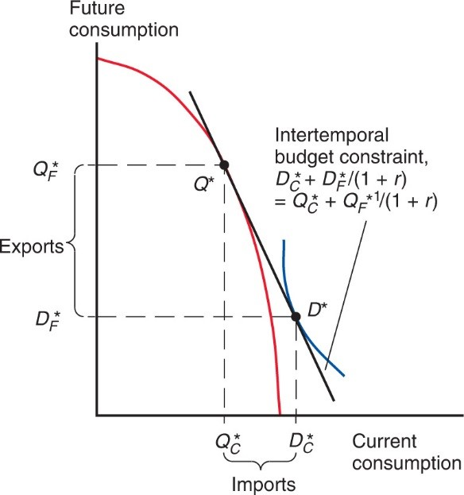
Figure 6A1.3 Determining Foreign’s Intertemporal Production and Consumption Patterns
Foreign produces at point
and consumes at point
importing
units of current consumption and exporting
units of future consumption.
Notes:
The curve falls with increasing steepness through point Q asterisk. At point Q asterisk, x = Q sub C asterisk and y = Q sub F asterisk. An isovalue line represents the intertemporal budget constraint, D sub C asterisk + D sub F asterisk, over, 1 + r, = Q sub C asterisk +, Q sub F asterisk over 1 + r. Below point Q and to the right of the curve, is point D asterisk on the isovalue line. An indifference curve passes through point D asterisk. At point D, x = D sub C asterisk and y = D sub F asterisk. On the y-axis the difference between point Q asterisk sub F and D asterisk sub F represents exports. On the x-axis, the difference between D sub C asterisk and Q sub C asterisk represents imports.

Slide 63

Copyright
This work is protected by United States copyright laws and is provided solely for the use of instructors in teaching their courses and assessing student learning. Dissemination or sale of any part of this work (including on the World Wide Web) will destroy the integrity of the work and is not permitted. The work and materials from it should never be made available to students except by instructors using the accompanying text in their classes. All recipients of this work are expected to abide by these restrictions and to honor the intended pedagogical purposes and the needs of other instructors who rely on these materials.

